Slide 1
第8章 激光原理与典型激光器
本章教学内容：
（1） 激光的基本原理，
（2）典型的激光器类型

Slide 2
Lasers

Slide 3
A laser is a device that emits light through a process of optical amplification based on the stimulated emission of electromagnetic radiation. The term "laser" originated as an acronym for "light amplification by stimulated emission of radiation".

Slide 4
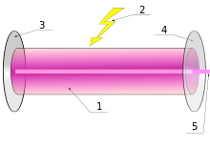
Components of a typical laser:
Gain medium
Laser pumping energy
High reflector
Output coupler
Laser beam

Slide 5
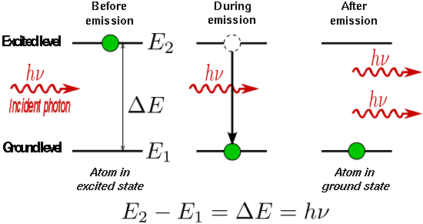
Stimulated emission
The liberated energy transfers to the electromagnetic field, creating a new photon with a phase, frequency, polarization, and direction of travel that are all identical to the photons of the incident wave. This is in contrast to spontaneous emission, which occurs at random intervals without regard to the ambient electromagnetic field.

Slide 6
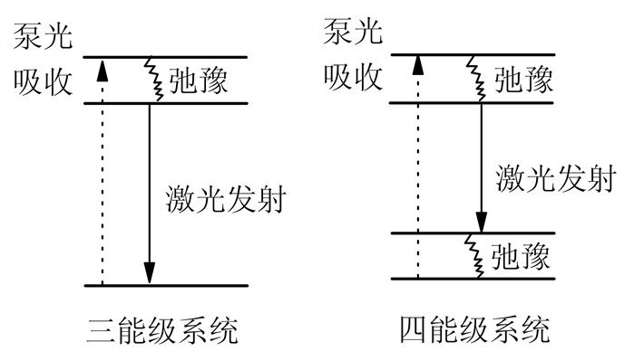

Slide 7
Coherence
A laser differs from other sources of light in that it emits light coherently. Spatial coherence allows a laser to be focused to a tight spot, enabling applications such as laser cutting and lithography. Spatial coherence also allows a laser beam to stay narrow over great distances (collimation), enabling applications such as laser pointers. Lasers can also have high temporal coherence, which allows them to emit light with a very narrow spectrum, i.e., they can emit a single color of light.

Slide 8
Categories of lasers

Slide 9
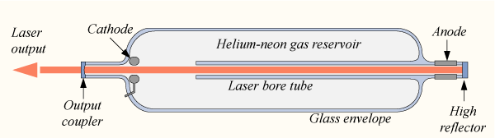
Gas lasers
Gas lasers using many different gases have been built and used for many purposes. The helium–neon laser (HeNe) is able to operate at a number of different wavelengths, however the vast majority are engineered to lase at 633 nm

Slide 10
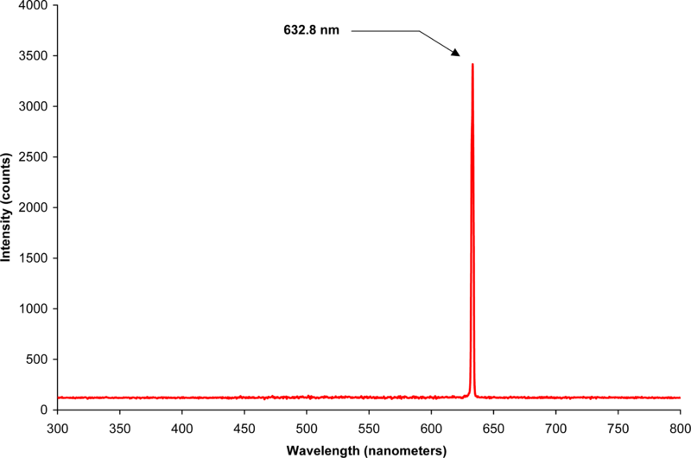
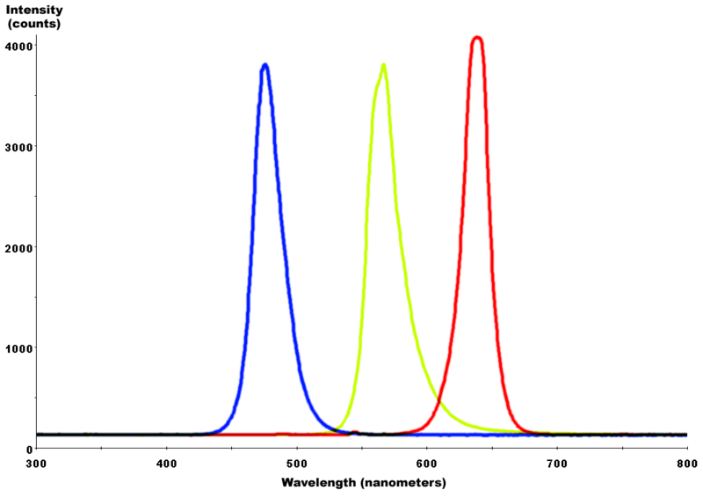
LED
Spectrum of a helium neon laser illustrating its very high spectral purity (limited by the measuring apparatus). The 0.002 nm bandwidth of the stimulated emission medium is well over 10,000 times narrower than the spectral width of a light-emitting diode

Slide 11
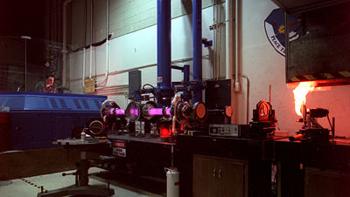
Gas lasers
Commercial carbon dioxide (CO_{2) lasers} can emit many hundreds of watts in a single spatial mode which can be concentrated into a tiny spot. This emission is in the thermal infrared at 10.6 µm; such lasers are regularly used in industry for cutting and welding. The efficiency of a CO₂ laser is unusually high: over 30%.

Slide 12
Argon-ion lasers can operate at a number of lasing transitions between 351 and 528.7 nm. Depending on the optical design one or more of these transitions can be lasing simultaneously; the most commonly used lines are 458 nm, 488 nm and 514.5 nm.

Slide 13
Excimer lasers
Excimer lasers are a special sort of gas laser powered by an electric discharge in which the lasing medium is an excimer
These are molecules which can only exist with one atom in an excited electronic state. Once the molecule transfers its excitation energy to a photon, therefore, its atoms are no longer bound to each other and the molecule disintegrates. This drastically reduces the population of the lower energy state thus greatly facilitating a population inversion.

Slide 14
Excimer lasers
Excimer lasers typically operate at ultraviolet wavelengths with major applications including semiconductor photolithography and LASIK eye surgery.
Commonly used excimer molecules include ArF (emission at 193 nm), KrCl (222 nm), KrF (248 nm), XeCl (308 nm), and XeF (351 nm).^{[29]}
The molecular fluorine laser, emitting at 157 nm in the vacuum ultraviolet is sometimes referred to as an excimer laser, however this appears to be a misnomer inasmuch as F₂ is a stable compound.

Slide 15
Chemical lasers
Chemical lasers are powered by a chemical reaction permitting a large amount of energy to be released quickly. Such very high power lasers are especially of interest to the military, however continuous wave chemical lasers at very high power levels, fed by streams of gasses, have been developed and have some industrial applications.
As examples, in the hydrogen fluoride laser (2700–2900 nm) and the deuterium fluoride laser (3800 nm) the reaction is the combination of hydrogen or deuterium gas with combustion products of ethylene in nitrogen trifluoride.

Slide 16
Solid-state lasers
Solid-state lasers use a crystalline or glass rod which is "doped" with ions that provide the required energy states. For example, the first working laser was a ruby laser, made from ruby. The population inversion is actually maintained in the dopant.
These materials are pumped optically using a shorter wavelength than the lasing wavelength, often from a flashtube or from another laser. The usage of the term "solid-state" in laser physics is narrower than in typical use. Semiconductor lasers (laser diodes) are typically not referred to as solid-state lasers.

Slide 17
Neodymium(钕) is a common dopant in various solid-state laser crystals, including yttrium orthovanadate(钒酸钇) (Nd:YVO₄), yttrium lithium fluoride (钇锂氟化物)(Nd:YLF), and yttrium aluminium garnet(钇铝石榴石) (Nd:YAG). All these lasers can produce high powers in the infrared spectrum at 1064 nm. They are used for cutting, welding and marking of metals and other materials, and also in spectroscopy and for pumping dye lasers. These lasers are also commonly frequency doubled, tripled or quadrupled to produce 532 nm (green, visible), 355 nm and 266 nm (UV) beams, respectively. Frequency-doubled diode-pumped solid-state (DPSS) lasers are used to make bright green laser pointers.

Slide 18
Solid-state lasers
Ytterbium, holmium, thulium, and erbium are other common "dopants" in solid-state lasers.^{[30]} Ytterbium is used in crystals such as Yb:YAG, Yb:KGW, Yb:KYW, Yb:SYS, Yb:BOYS, Yb:CaF₂, typically operating around 1020–1050 nm.
Holmium-doped YAG crystals emit at 2097 nm and form an efficient laser operating at infrared wavelengths strongly absorbed by water-bearing tissues. The Ho-YAG is usually operated in a pulsed mode, and passed through optical fiber surgical devices to resurface joints, remove rot from teeth, vaporize cancers, and pulverize kidney and gall stones.

Slide 19
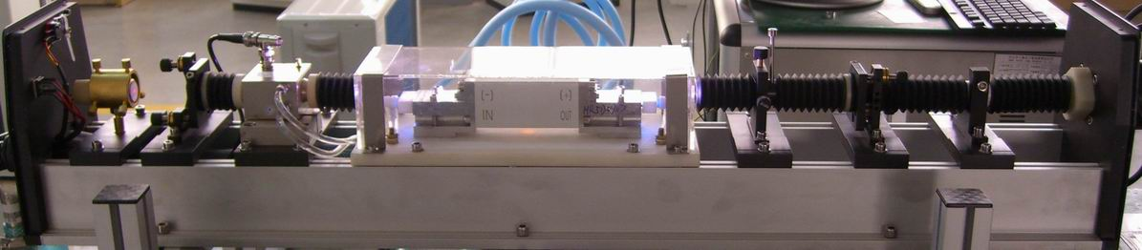
Solid-state lasers
Titanium-doped sapphire (Ti:sapphire) produces a highly tunable infrared laser, commonly used for spectroscopy. It is also notable for use as a mode-locked laser producing ultrashort pulses of extremely high peak power.
红光
全反膜片架
声光晶体
激光腔体
输出膜片架
扩束镜
光阑

Slide 20
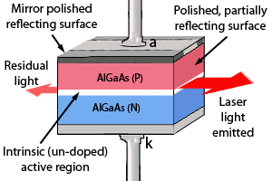
Semiconductor lasers
Semiconductor lasers are diodes which are electrically pumped. Recombination of electrons and holes created by the applied current introduces optical gain. Reflection from the ends of the crystal form an optical resonator, although the resonator can be external to the semiconductor in some designs.

Slide 21
Semiconductor lasers
Commercial laser diodes emit at wavelengths from 375 nm to 3500 nm. Low to medium power laser diodes are used in laser pointers, laser printers and CD/DVD players.
Laser diodes are also frequently used to optically pump other lasers with high efficiency. The highest power industrial laser diodes, with power up to 10 kW (70 dBm) are used in industry for cutting and welding.

Slide 22
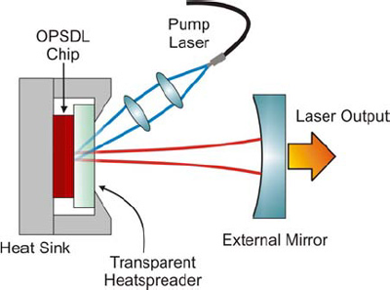
External-cavity semiconductor lasers have a semiconductor active medium in a larger cavity. These devices can generate high power outputs with good beam quality, wavelength-tunable narrow-linewidth radiation, or ultrashort laser pulses.
Temperature effect
And cooling

Slide 23
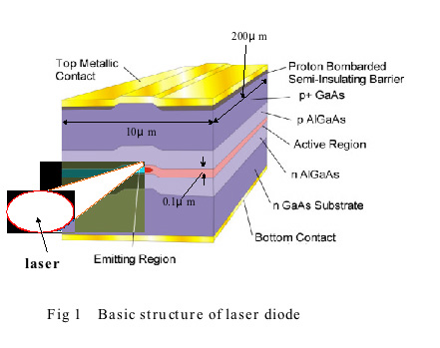
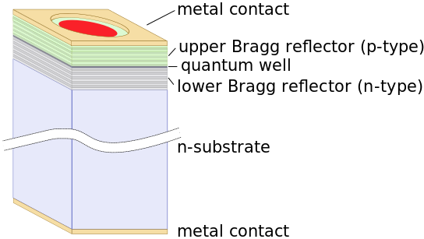
Vertical cavity surface-emitting lasers (VCSELs) are semiconductor lasers whose emission direction is perpendicular to the surface of the wafer. VCSEL devices typically have a more circular output beam than conventional laser diodes.
As of 2005, only 850 nm VCSELs are widely available, with 1300 nm VCSELs beginning to be commercialized, and 1550 nm devices an area of research.

Slide 24
Edge-emitters cannot be tested until the end of the production process. If the edge-emitter does not function properly, whether due to bad contacts or poor material growth quality, the production time and the processing materials have been wasted. VCSELs however, can be tested at several stages throughout the process to check for material quality and processing issues.
because VCSELs emit the beam perpendicular to the active region of the laser as opposed to parallel as with an edge emitter, tens of thousands of VCSELs can be processed simultaneously on a three-inch gallium arsenide wafer.
Single mode.

Slide 25
Silicon laser
The development of a silicon laser is important in the field of optical computing. Silicon is the material of choice for integrated circuits, and so electronic and silicon photonic components (such as optical interconnects) could be fabricated on the same chip.
Recently teams have produced silicon lasers through methods such as fabricating the lasing material from silicon and other semiconductor materials, materials which allow coherent light to be produced from silicon. These are called hybrid silicon laser. Another type is a Raman laser, which takes advantage of Raman scattering to produce a laser from materials such as silicon.

Slide 26
Free-electron lasers
Free-electron lasers, or FELs, generate coherent, high power radiation that is widely tunable, currently ranging in wavelength from microwaves through terahertz radiation and infrared to the visible spectrum, to soft X-rays. They have the widest frequency range of any laser type. While FEL beams share the same optical traits as other lasers, such as coherent radiation, FEL operation is quite different.
Unlike gas, liquid, or solid-state lasers, which rely on bound atomic or molecular states, FELs use a relativistic electron beam as the lasing medium, hence the term free-electron.

Slide 27
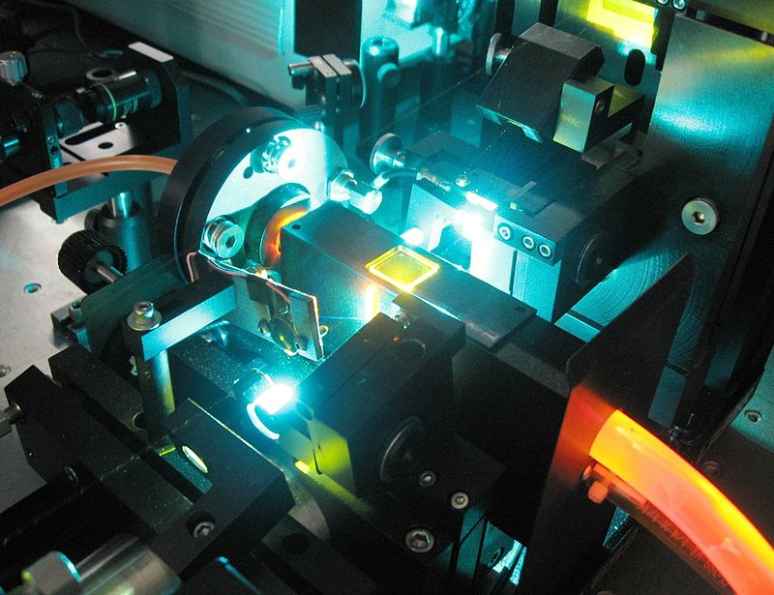
Dye lasers
A dye laser is a laser which uses an organic dye as the lasing medium, usually as a liquid solution. Compared to gases and most solid state lasing media, a dye can usually be used for a much wider range of wavelengths, often spanning 50 to 100 nanometers or more. The wide bandwidth makes them particularly suitable for tunable lasers and pulsed lasers.
The dye rhodamine 6G, for example, can be tuned from 635 nm (orangish-red) to 560 nm (greenish-yellow), and produce pulses as short as 16 femtoseconds

Slide 28
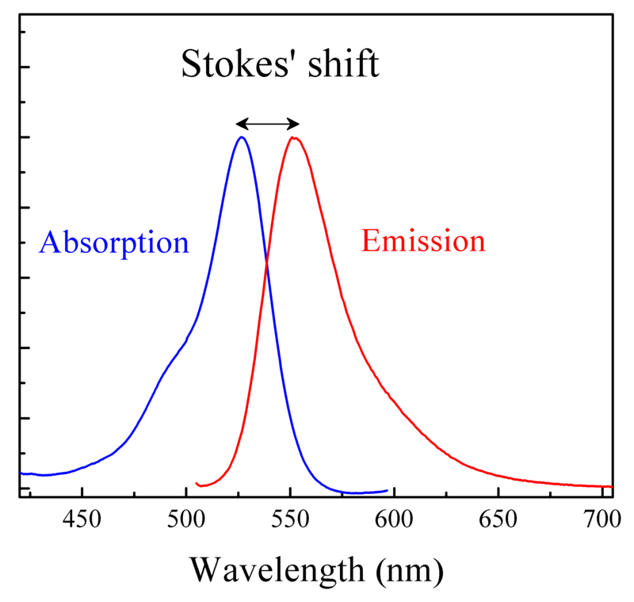

Slide 29
the dye can be replaced by another type in order to generate an even broader range of wavelengths with the same laser, from the near-infrared to the near-ultraviolet, although this usually requires replacing other optical components in the laser as well, such as dielectric mirrors or pump lasers.

Slide 30
Solid dye lasers
Although these tunable lasers are mainly known in their liquid form, researchers have also demonstrated narrow-linewidth tunable emission in dispersive oscillator configurations incorporating solid-state dye gain media. In their most prevalent form these solid state dye lasers use dye-doped polymers as laser media.

Slide 31
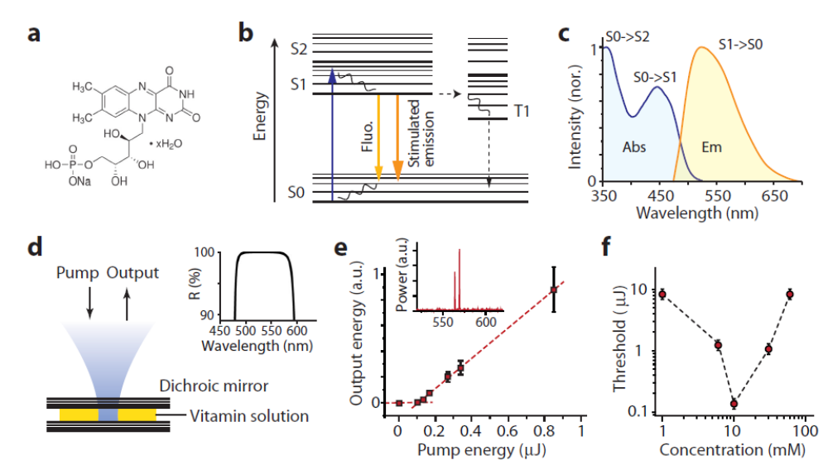

Microfluidic lasers

Slide 32
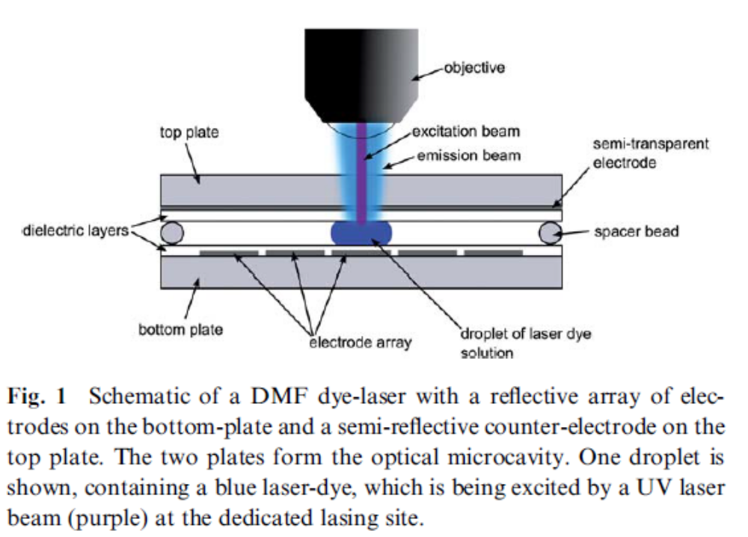
Droplet laser

Slide 33
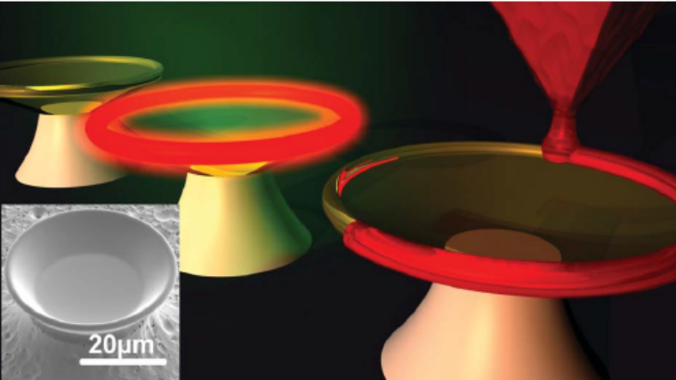
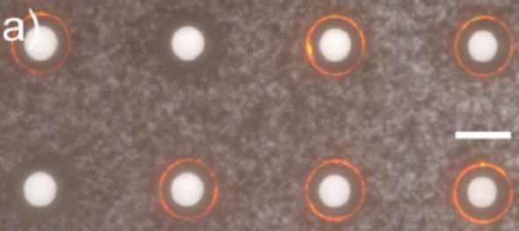

Slide 34
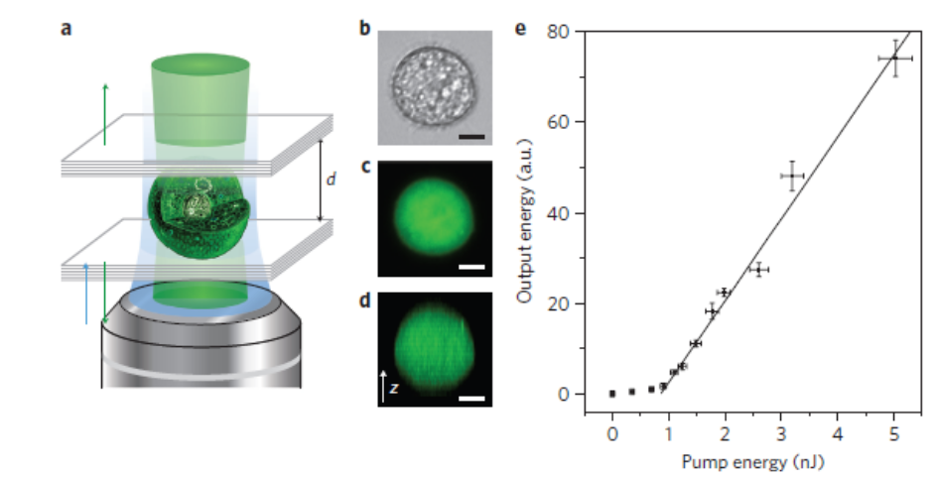
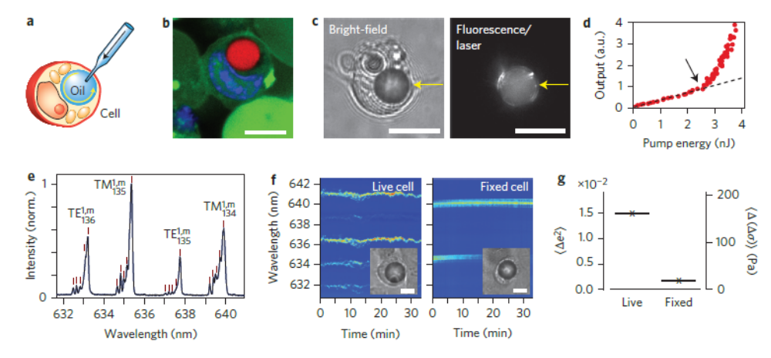

Slide 35
Fiber lasers
A fiber laser or fibre laser is a laser in which the active gain medium is an optical fiber.

Slide 36
Fiber lasers
Optical fiber
Gain, doped fiber
Fiber amplifier
Pump, fiber structure/coupling
Resonator

Slide 37
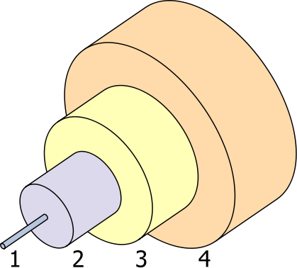
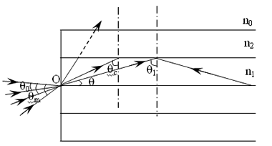
Optical fiber
NA

Slide 38
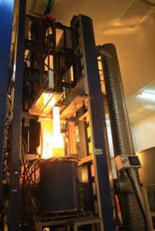
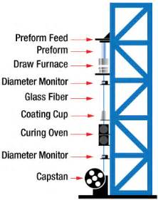
Optical fiber fabrication

Slide 39
Optical fiber
doped with rare-earth elements such as erbium, ytterbium, neodymium, dysprosium, praseodymium, thulium and holmium.

Slide 40
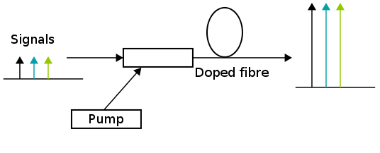
Doped fibre amplifiers
Erbium is a chemical element with symbol Er and atomic number 68.
EDFA
Difference between laser and amplifier?

Slide 41
EDFA
Doped fibre amplifiers (DFAs) are optical amplifiers that use a doped optical fibre as a gain medium to amplify an optical signal. They are related to fibre lasers. The signal to be amplified and a pump laser are multiplexed into the doped fibre, and the signal is amplified through interaction with the doping ions. The most common example is the Erbium Doped Fibre Amplifier (EDFA), where the core of a silica fibre is doped with trivalent erbium ions and can be efficiently pumped with a laser at a wavelength of 980 nm or 1,480 nm, and exhibits gain in the 1,550 nm region.

Slide 42
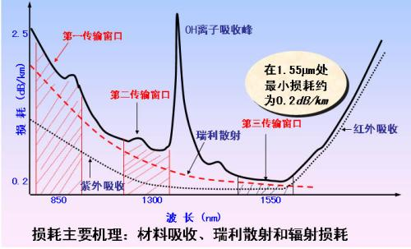
Attenuation in optical fibers

Slide 43
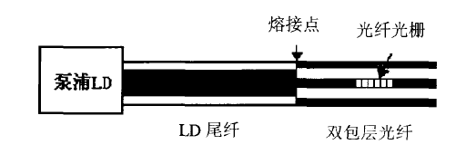
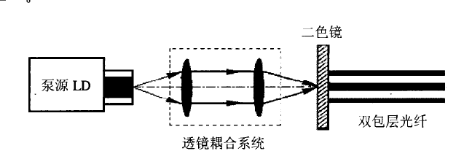
Pump for fiber lasers
Diode laser, advantages
Coupling to SMF, efficiency?

Slide 44
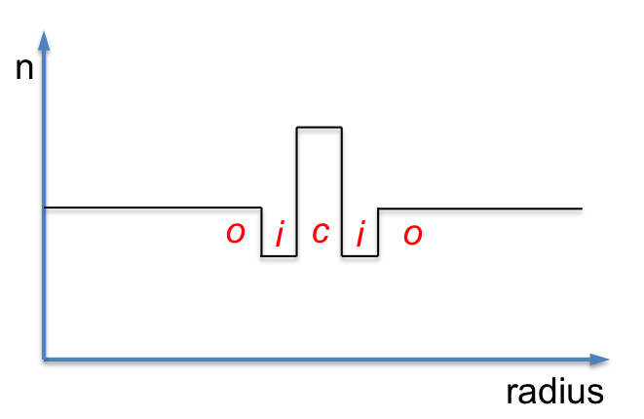
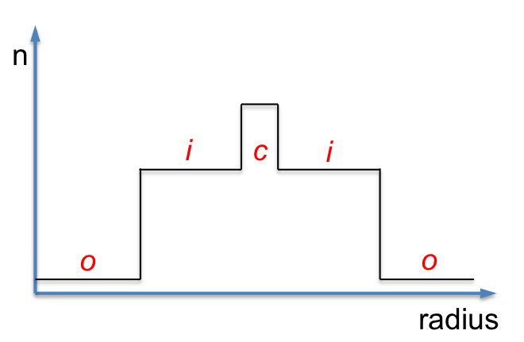

Slide 45
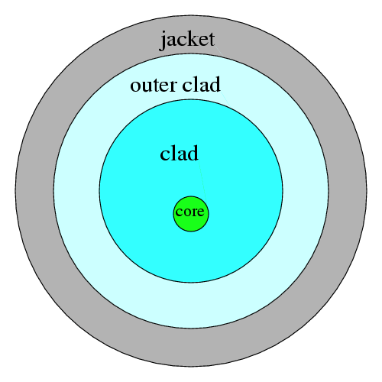

Slide 46
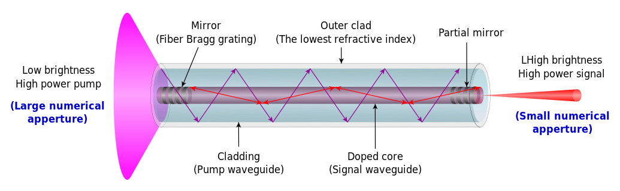
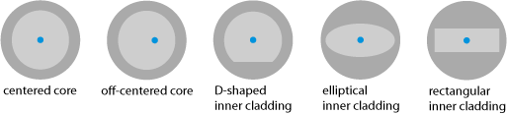

Slide 47
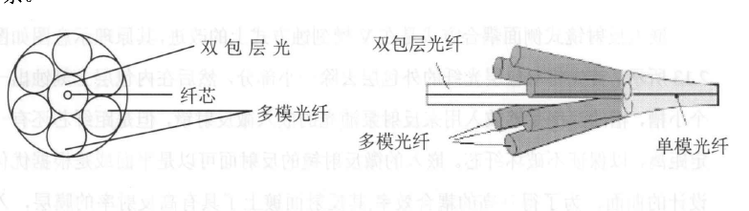

Slide 48
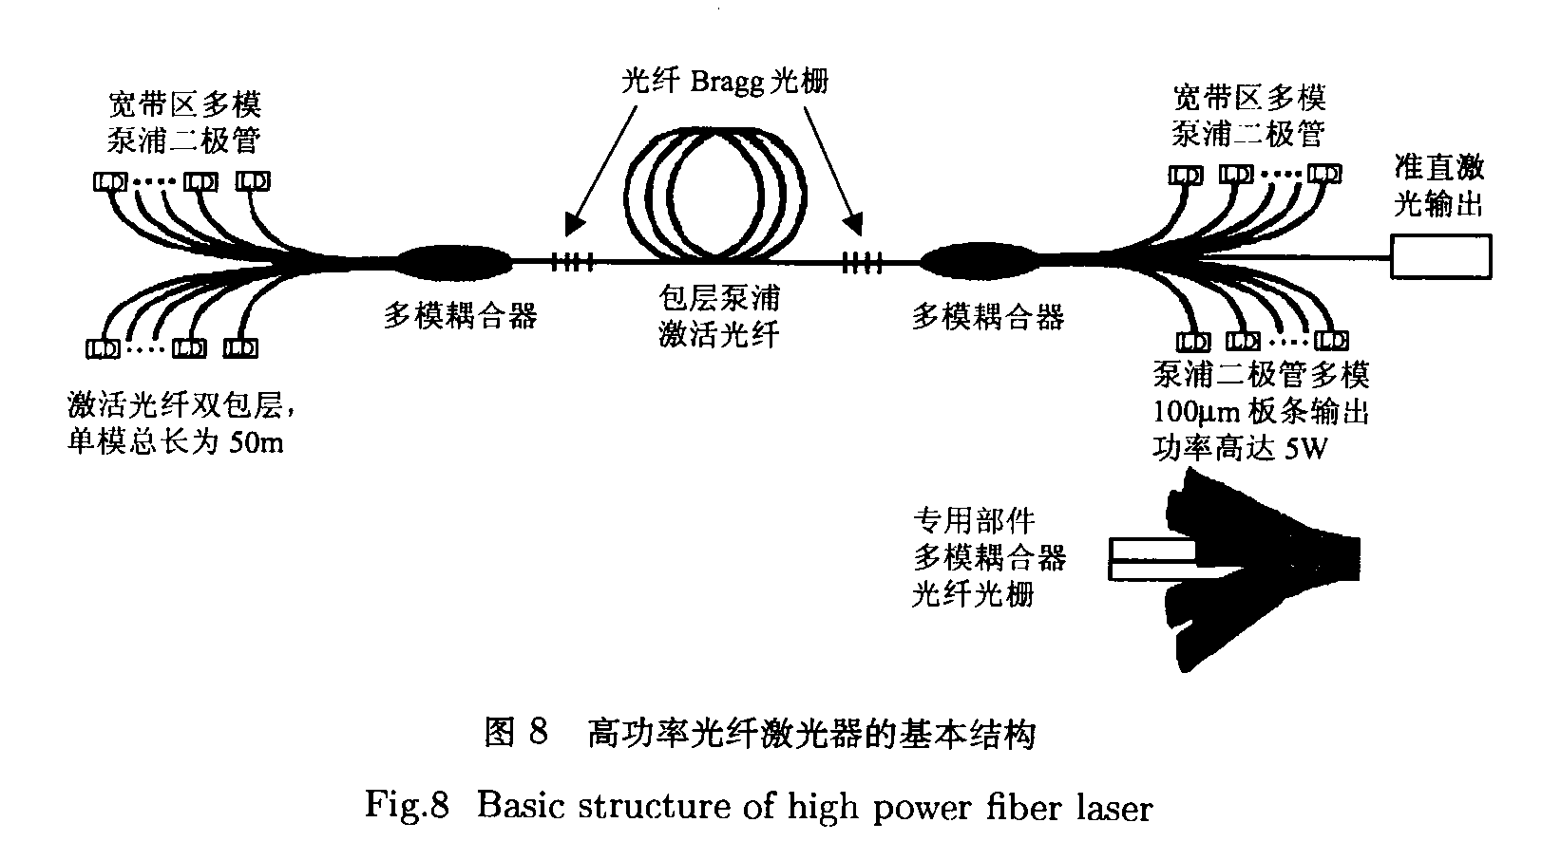

Slide 49
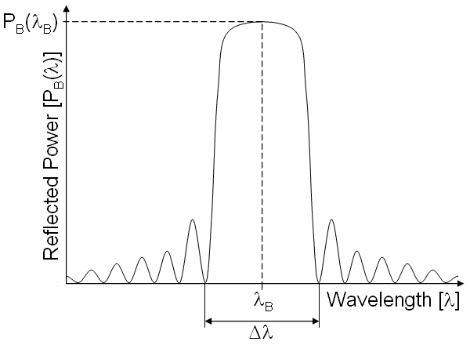
Resonator for fiber lasers
EDF
泵浦
FBG
FBG

Slide 50
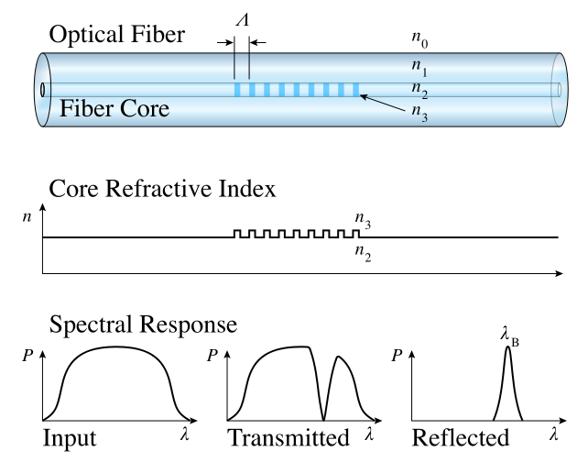
FBG

Slide 51
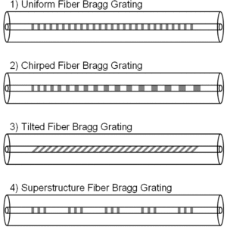
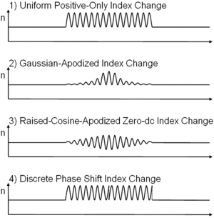

Slide 52
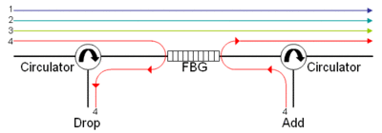

Slide 53
Resonator for fiber lasers
EDF
环形器
WDM
泵浦
FBG

Slide 54
Output
PC controller
Output coupler
Isolator
WDM
EDF
泵浦

Slide 55
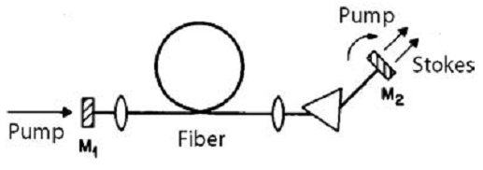
Fiber lasers
Fiber nonlinearities, such as stimulated Raman scattering or four-wave mixing can also provide gain and thus serve as gain media for a fiber laser.

Slide 56
Fiber lasers
Advantages
Compact size: Fiber lasers are compact compared to rod or gas lasers of comparable power, because the fiber can be bent and coiled to save space.

Slide 57
Fiber lasers
Advantages
High optical quality: The fiber's waveguiding properties reduce or eliminate thermal distortion of the optical path, typically producing a diffraction-limited, high-quality optical beam.

Slide 58
Fiber lasers
Advantages
High output power: Fiber lasers can have active regions several kilometers long, and so can provide very high optical gain. They can support kilowatt levels of continuous output power because of the fiber's high surface area to volume ratio, which allows efficient cooling.
High peak power and nanosecond pulses enable effective marking and engraving.

Slide 59
Fiber lasers
Advantages
Reliability: Fiber lasers exhibit high temperature and vibrational stability, extended lifetime, and maintenance-free turnkey operation.
Lower cost
Light is already coupled into a flexible fiber: The fact that the light is already in a fiber allows it to be easily delivered to a movable focusing element. This is important for laser cutting, welding, and folding of metals and polymers.

Slide 60
Recent innovations
Since the early period of laser history, laser research has produced a variety of improved and specialized laser types, optimized for different performance goals, including:
new wavelength bands
High average output power / High peak pulse energy
Short output pulse duration
High power efficiency
Narrow linewidth
Miniature size
Random lasers

